Slide 1

Workout Management System
Mohammad Waseem Khan
22MayEnable2

Slide 2
Introduction
Workout management system will help us to manage exercise with respect to time and calories.
Workout may have multiple exercises.

Slide 3

Tools
Following tools are used to complete this project:
Eclipse
MySQL workbench
Visual Studio Code
Jira

Slide 4

Objective
The main objective of this project to do hands-on application on spring boot with java framework.
By using spring boot, I need to create a web application
And to understand how to do unit testing with Junit and Mockito
A front-end developed using JavaScript, HTML and CSS.

Slide 5
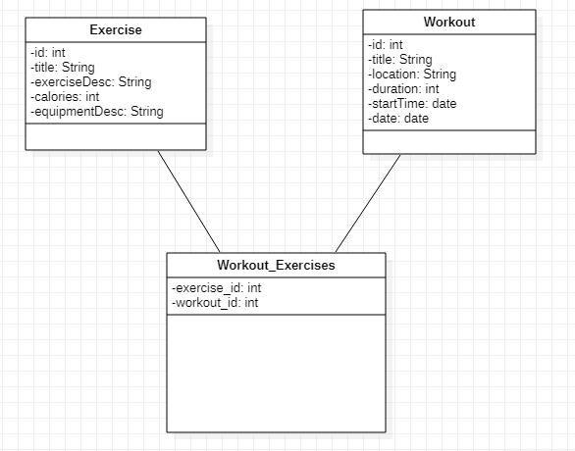
ERD

Slide 6
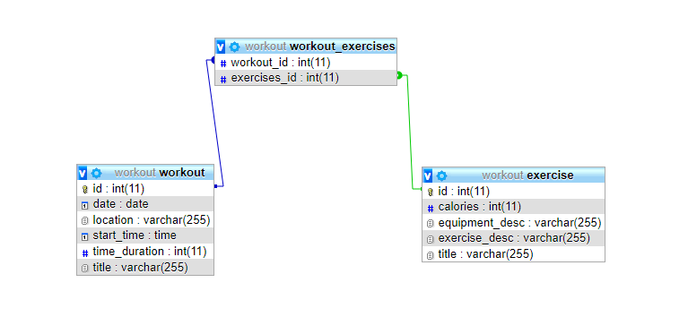
UML

Slide 7
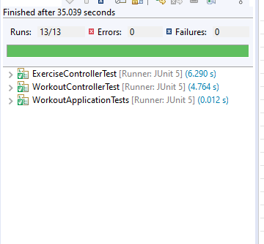
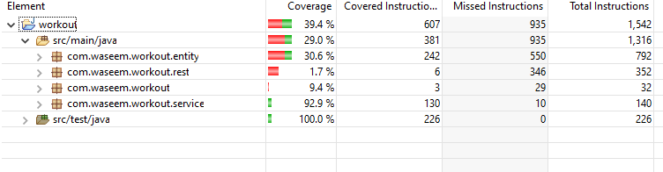
Test Coverage

Slide 8
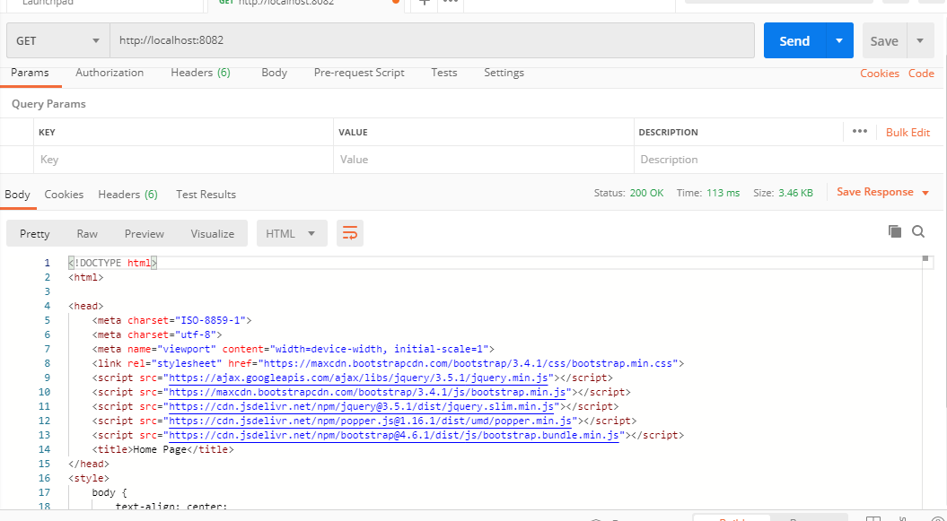
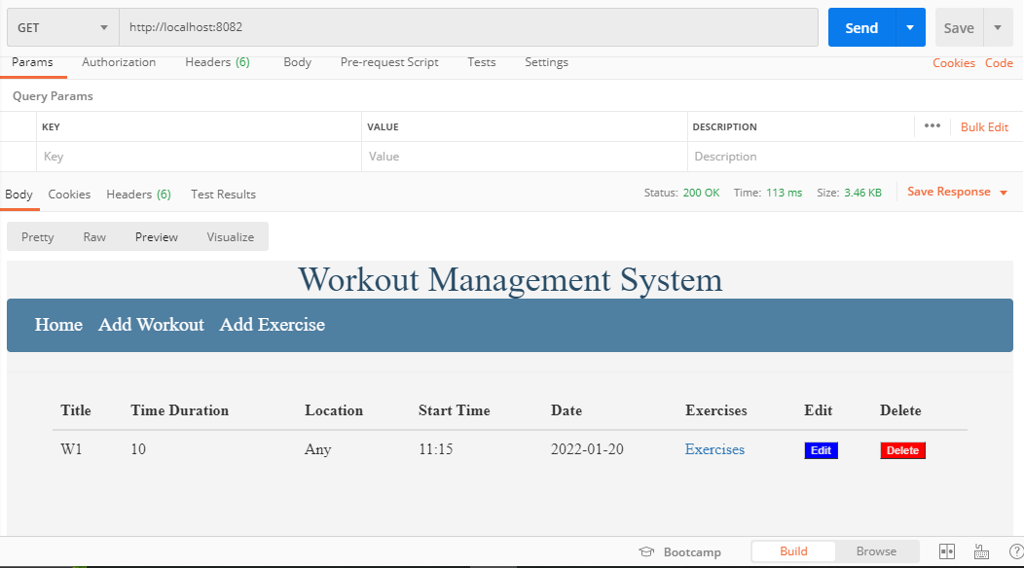
Postman Canary

Slide 9

Developer Journey
I have followed following steps to complete this project
I selected the idea
I created model classes with logical structure using ERD
Then I created repositories and controller with rest APIs
Then I created frontend in html and connected it with APIs
Finally, I added test cases for unit testing

Slide 10
Challenges Faced
Poor WIFI connection due to new provider
GitHub complications
Time management - Jira

Slide 11

Thank You

